Slide 1
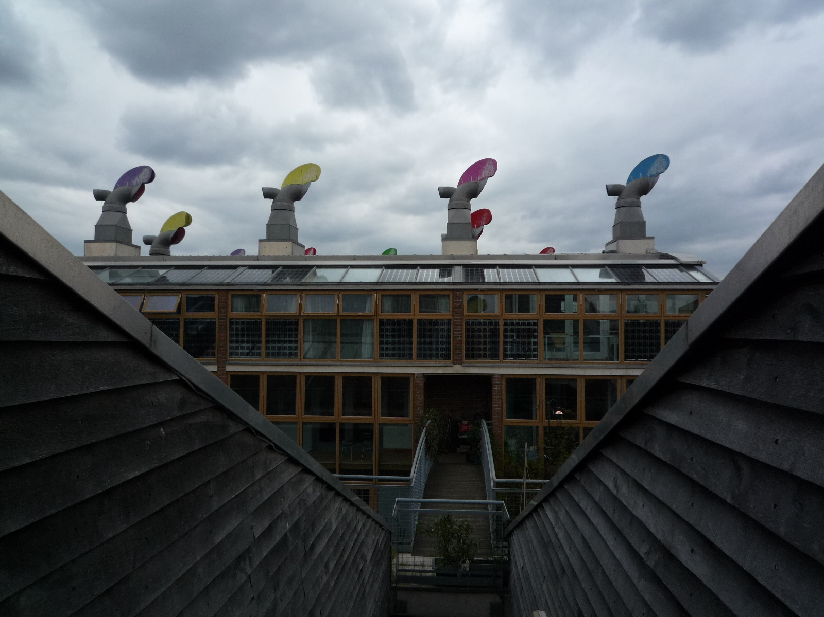
Is London getting greener?
A data analysis
Yatwan Hui April 2022

Slide 2
Tableau Public
Video tutorial
Connecting to spatial files

Slide 3
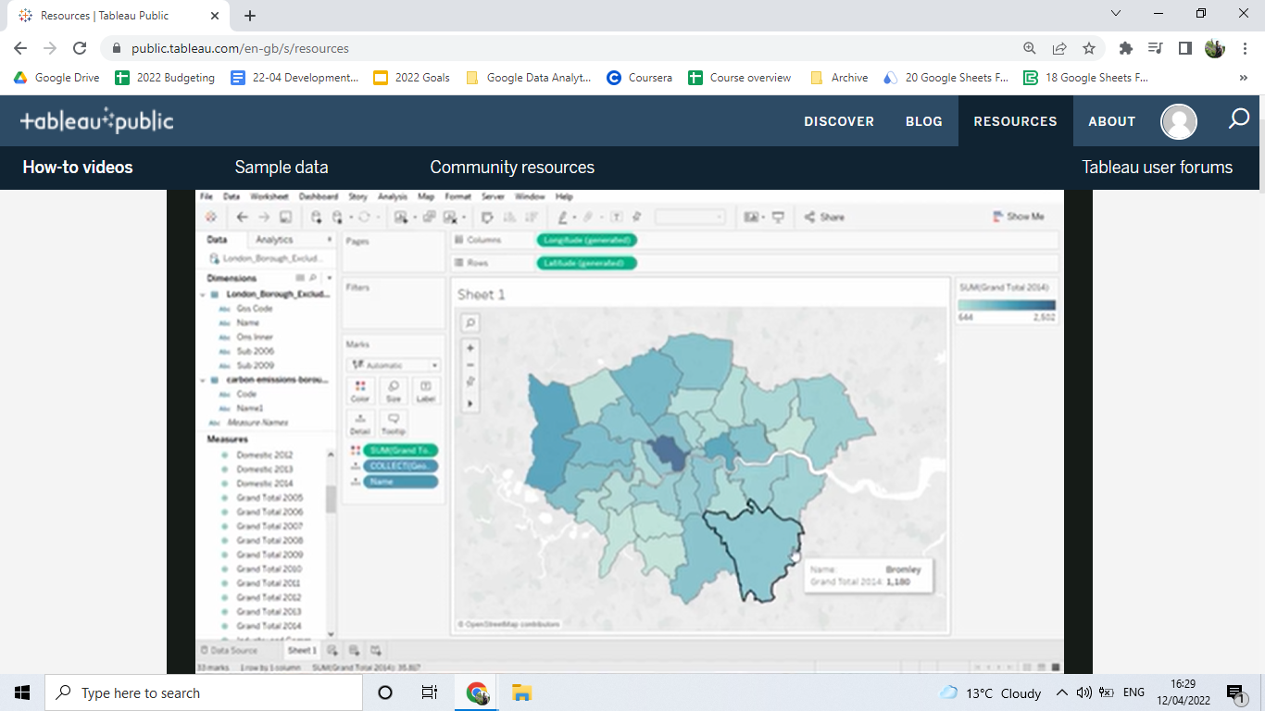
Tableau Public
Video tutorial
Connecting to spatial files
London borough.shp
Carbon emissions.xlsx
https://public.tableau.com/en-gb/s/resources

Slide 4
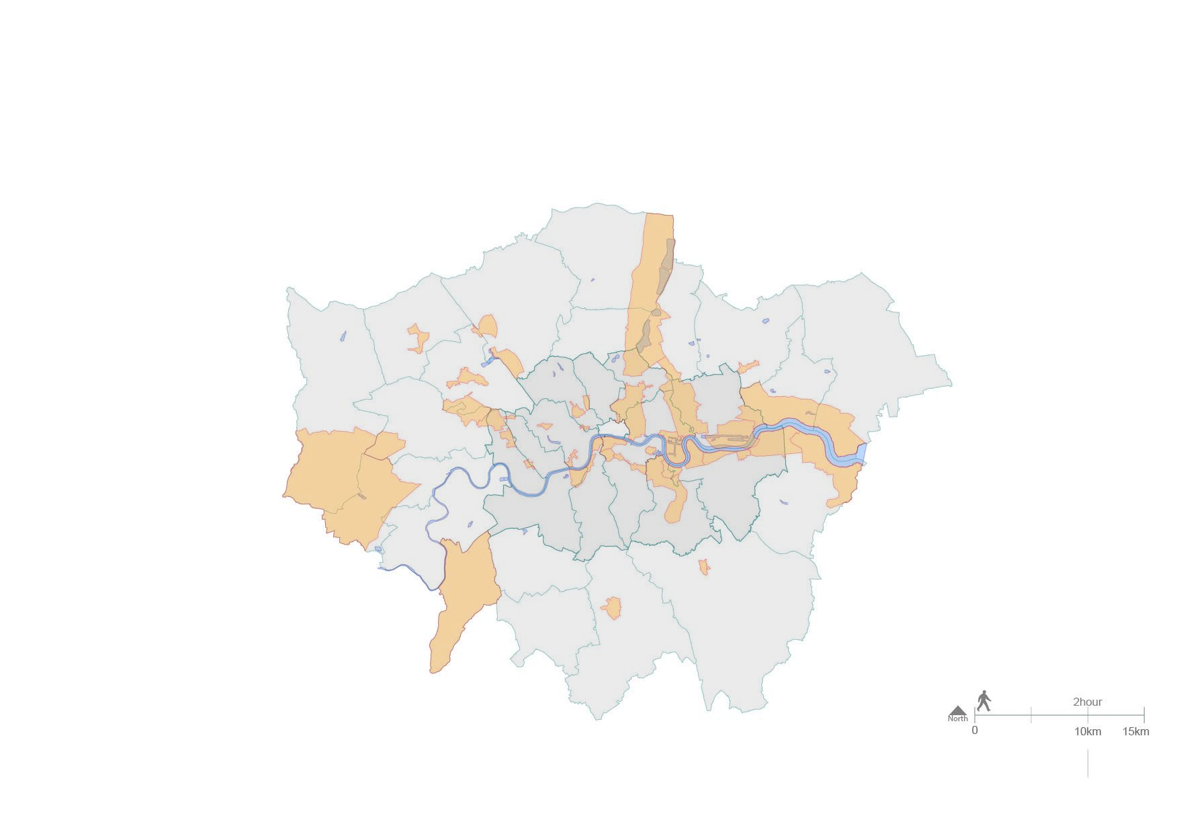
Strategic urban planning
Greater London Authority
2010 - 2017
Esri ArcGIS

Slide 5
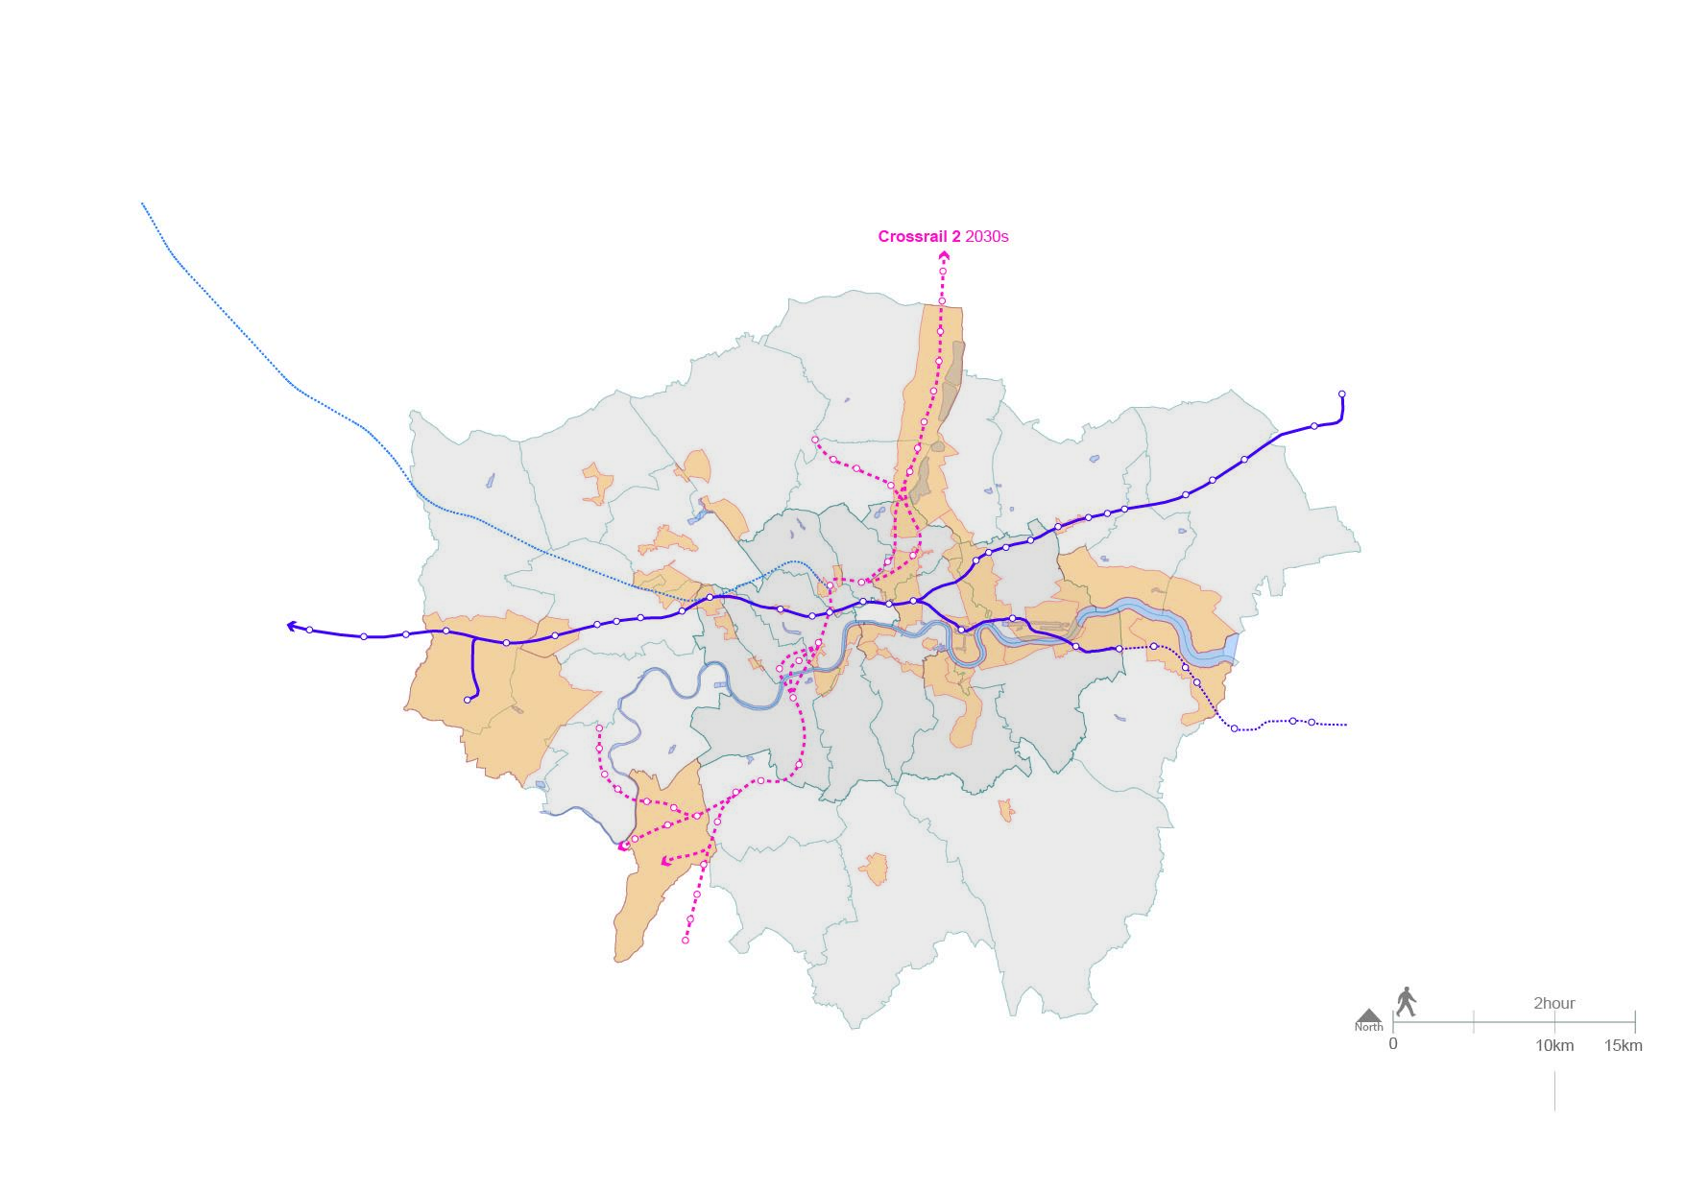
Strategic urban planning
Greater London Authority
2010 - 2017
Esri ArcGIS
Adobe Illustrator

Slide 6
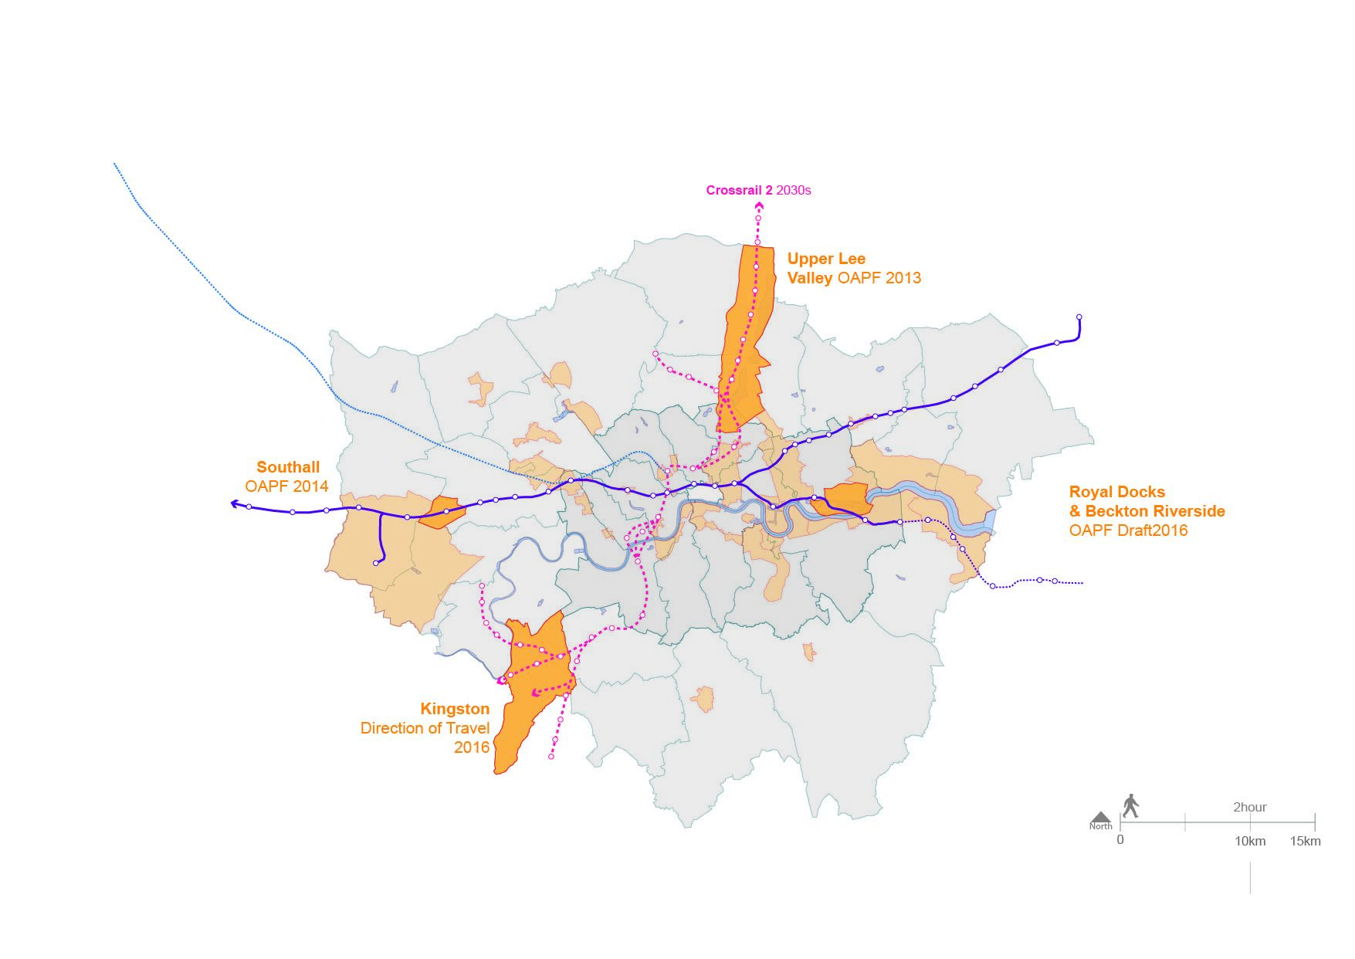
Strategic urban planning
Greater London Authority
2010 - 2017
Esri ArcGIS
Adobe Illustrator
Adobe InDesign

Slide 7
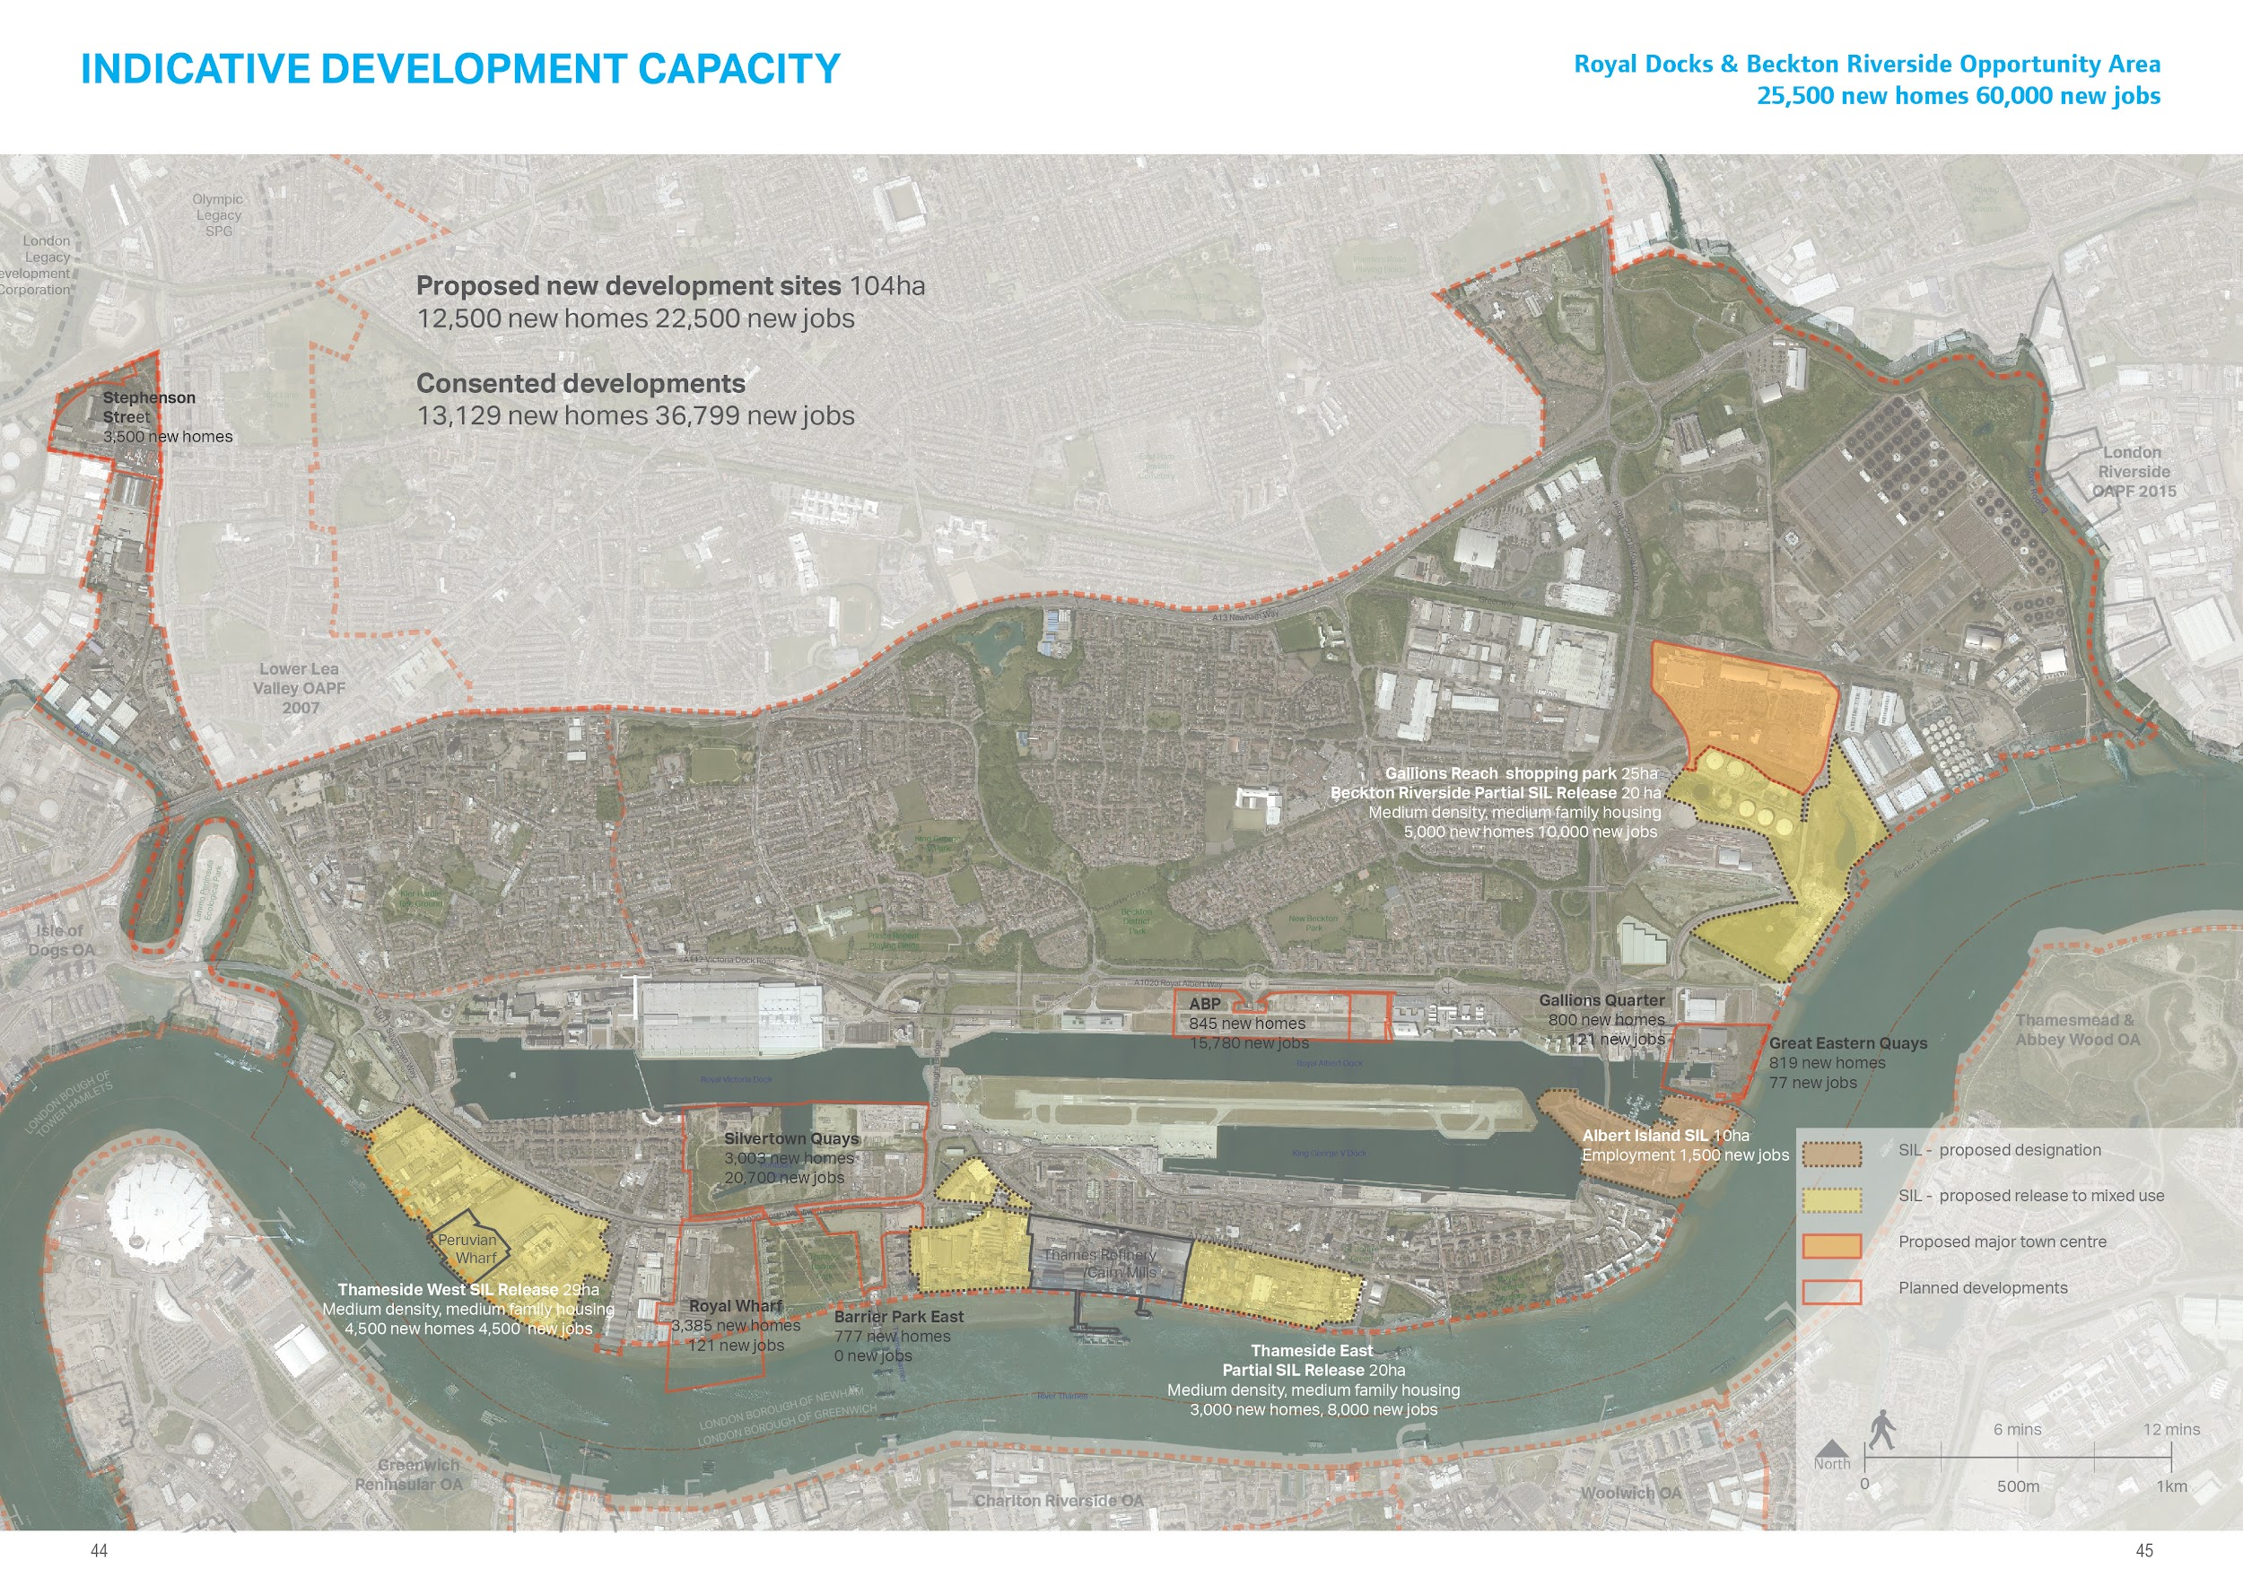
Strategic urban planning
Greater London Authority
2010 - 2017
Esri ArcGIS
Adobe Illustrator
Adobe InDesign
Excel
Royal Docks Opportunity Area Planning Framework Working Draft 2017

Slide 8
London’s carbon emission

Slide 9
London’s carbon emission
October 2016
Department of Energy and Climate Change
By London borough
By sector
From 2005 - 2014

Slide 10
Questions
Which sector emits the most CO2?

Slide 11
Questions
Which sector emits the most CO2?
Which London borough uses the most energy?

Slide 12
Questions
Which sector emits the most CO2?
Which London borough uses the most energy?
Which borough’s energy use increased and decreased the most between 2005 and 2011?

Slide 13
Questions
Which sector emits the most CO2?
Which London borough uses the most energy?
Which borough’s energy use increased and decreased the most between 2005 and 2011?
How does this relate to the changes in sector?

Slide 14
Questions
Which sector emits the most CO2?
Which London borough uses the most energy?
Which borough’s energy use increased and decreased the most between 2005 and 2011?
How does this relate to the changes in sector?
Is there a correlation to urban regeneration?

Slide 15
Questions
Which sector emits the most CO2?
Which London borough uses the most energy?
Which borough’s energy use increased and decreased the most between 2005 and 2011?
How does this relate to the changes in sector?
Is there a correlation to urban regeneration? Industrial areas > residential / mixed-used

Slide 16
Questions
Which sector emits the most CO2?
Which London borough uses the most energy?
Which borough’s energy use increased and decreased the most between 2005 and 2011?
How does this relate to the changes in sector?
Is there a correlation to urban regeneration? Industrial areas > residential / mixed-used
Is London getting greener?

Slide 17
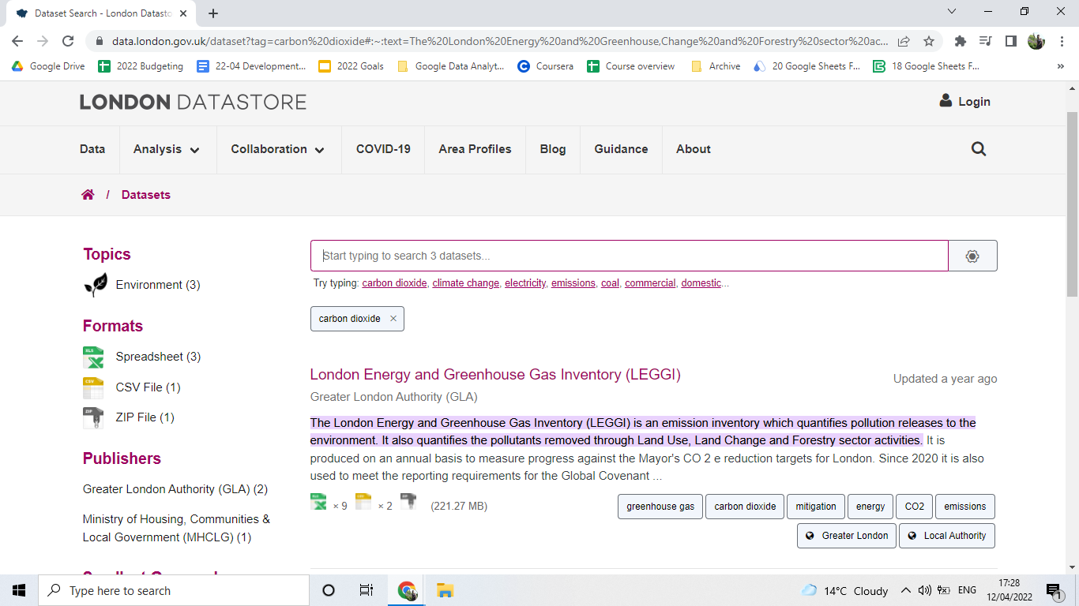

Slide 18
London Energy and Greenhouse Inventory
London Datastore
Spreadsheet 1:
Energy consumption KiloWatt/hour
https://data.london.gov.uk/dataset/leggi

Slide 19
London Energy and Greenhouse Inventory
London Datastore
Spreadsheet 1:
Energy consumption KiloWatt/hour
Spreadsheet 2:
Carbon emissions kilotonnes CO2
https://data.london.gov.uk/dataset/leggi

Slide 20
London Energy and Greenhouse Inventory
London Datastore
Spreadsheet 1:
Energy consumption KiloWatt/hour
Spreadsheet 2:
Carbon emissions kilotonnes CO2
33 London boroughs
3 sectors
12 fuel types
2010 to 2017
https://data.london.gov.uk/dataset/leggi

Slide 21
Sector: Domestic
Fuel type
Coal
Electricity
Gas
Oil
Total

Slide 22
Sector: Domestic
Fuel type
Coal
Electricity
Gas
Oil
Total
Sector: Industrial and commercial
Fuel type
Coal
Electricity
Electricity without rail
Gas
Oil
Waste and renewables
Total

Slide 23
Sector: Domestic
Fuel type
Coal
Electricity
Gas
Oil
Total
Sector: Industrial and commercial
Fuel type
Coal
Electricity
Electricity without rail
Gas
Oil
Waste and renewables
Total
Sector: Transport
Fuel type
Aviation
Railway diesel
Railway electric
Road Transport
Shipping
Total

Slide 24
Sector: Domestic
Fuel type
Coal
Electricity
Gas
Oil
Total
Sector: Industrial and commercial
Fuel type
Coal
Electricity
Electricity without rail
Gas
Oil
Waste and renewables
Total
Sector: Transport
Fuel type
Aviation
Railway diesel
Railway electric
Road Transport
Shipping
Total
Sector: Total
Fuel type
total

Slide 25
Question
Which sector emits the most CO2?

Slide 26
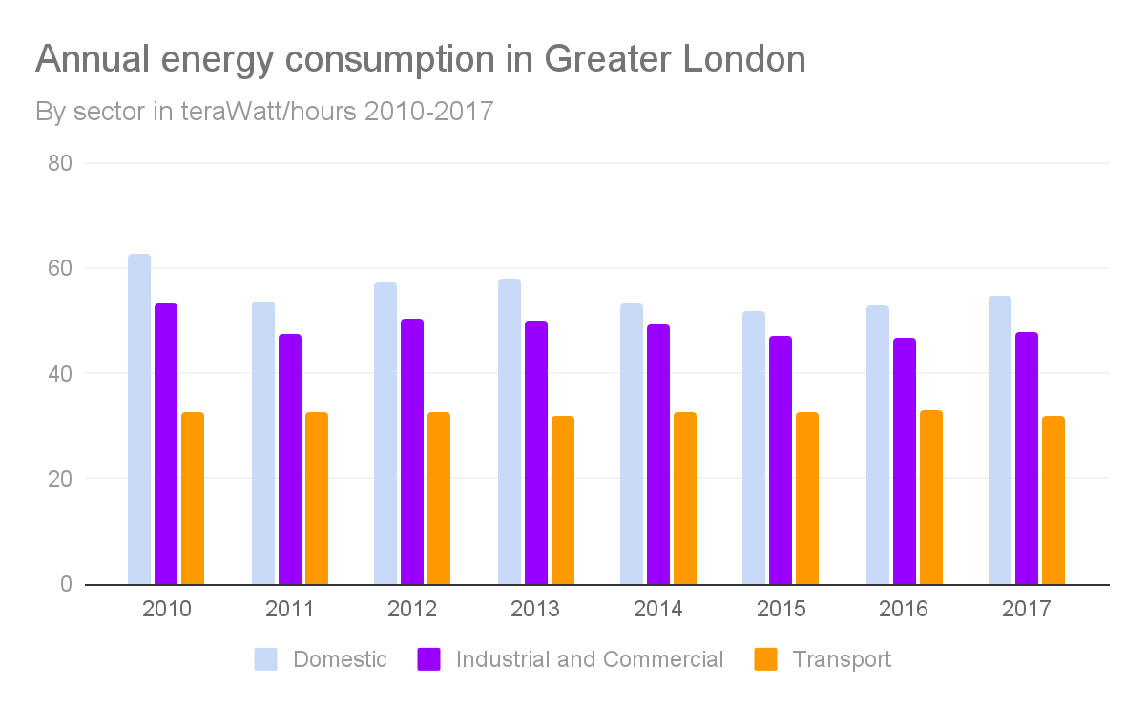

Slide 27
Domestic consumes the most energy

Slide 28
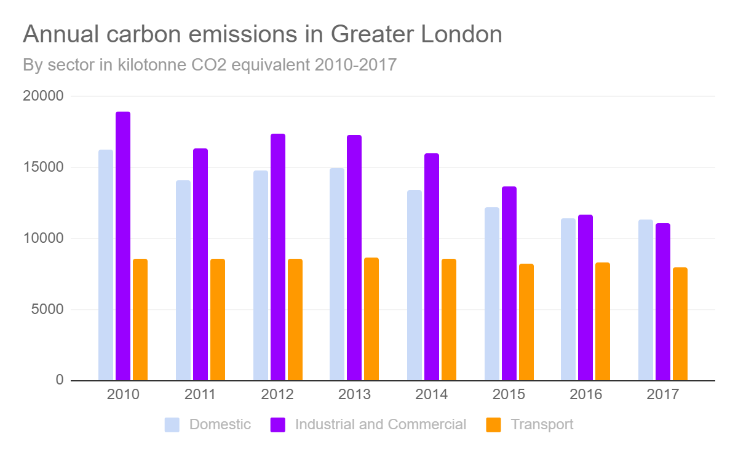
Domestic consumes the most energy

Slide 29
Domestic consumes the most energy
Industrial and commercial emits the most carbon. Emissions emissions generally falling

Slide 30
Domestic consumes the most energy
Industrial and commercial emits the most carbon. Emissions emissions generally falling
Little change in in transport consumption and emissions from 2010-2017

Slide 31
Question
Does carbon emission increase with energy consumption?

Slide 32
Question
Does carbon emission increase with energy consumption?
If no,

Slide 33
Question
Does carbon emission increase with energy consumption?
If no,
Did a change in fuel or technological improvement lower carbon emissions?

Slide 34
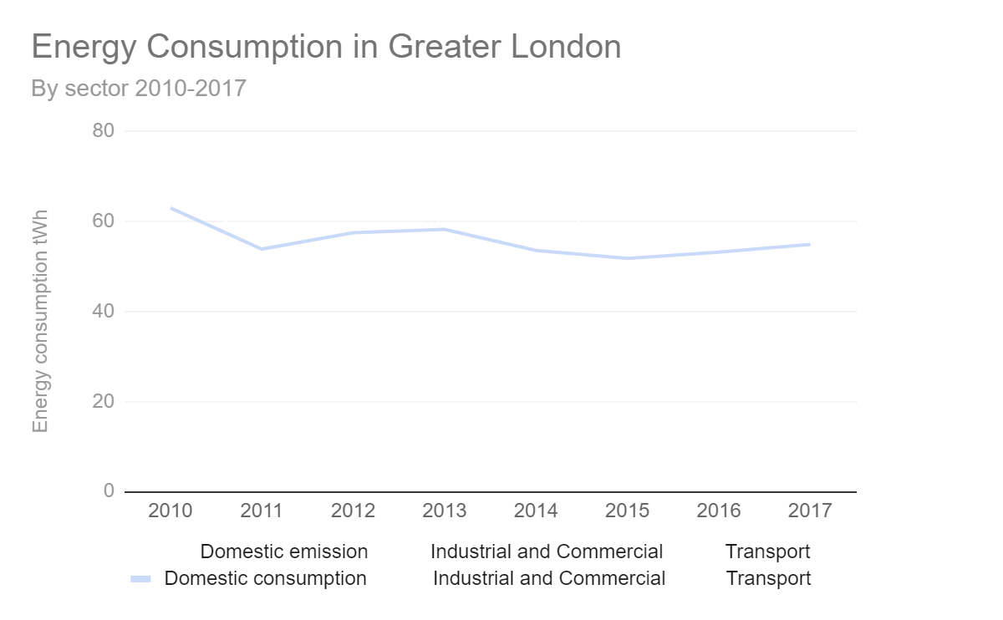
The domestic sector consumes 40% of London’s energy from 2010-2017.

Slide 35
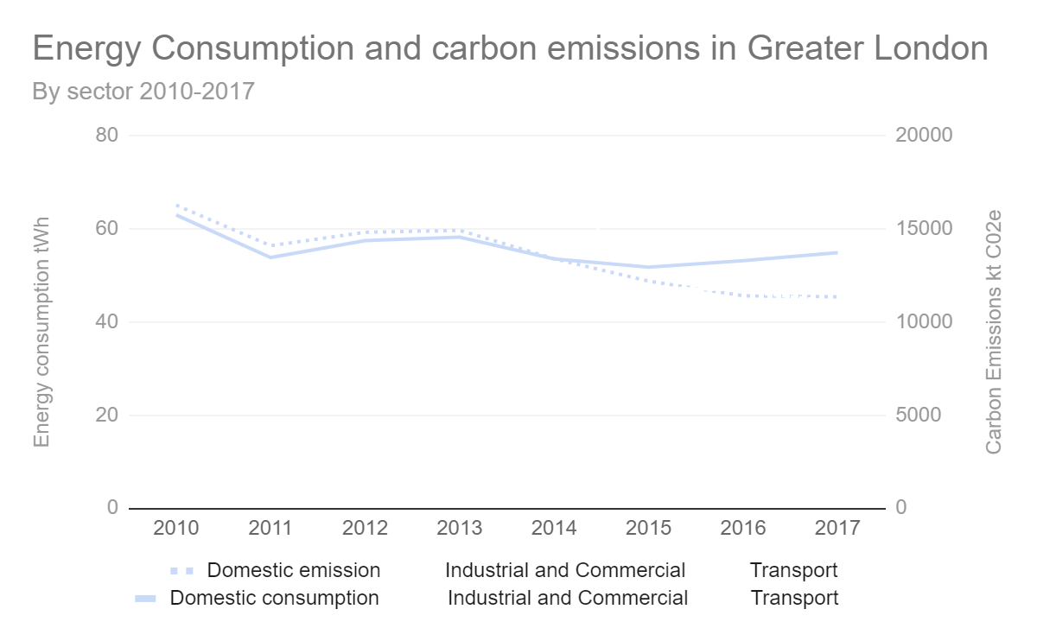
The domestic sector consumes 40% of London’s energy from 2010-2017.
But emits 36% of London’s carbon emissions.

Slide 36
The domestic sector consumes 40% of London’s energy from 2010-2017.
But emits 36% of London’s carbon emissions.
2014: lower emissions

Slide 37
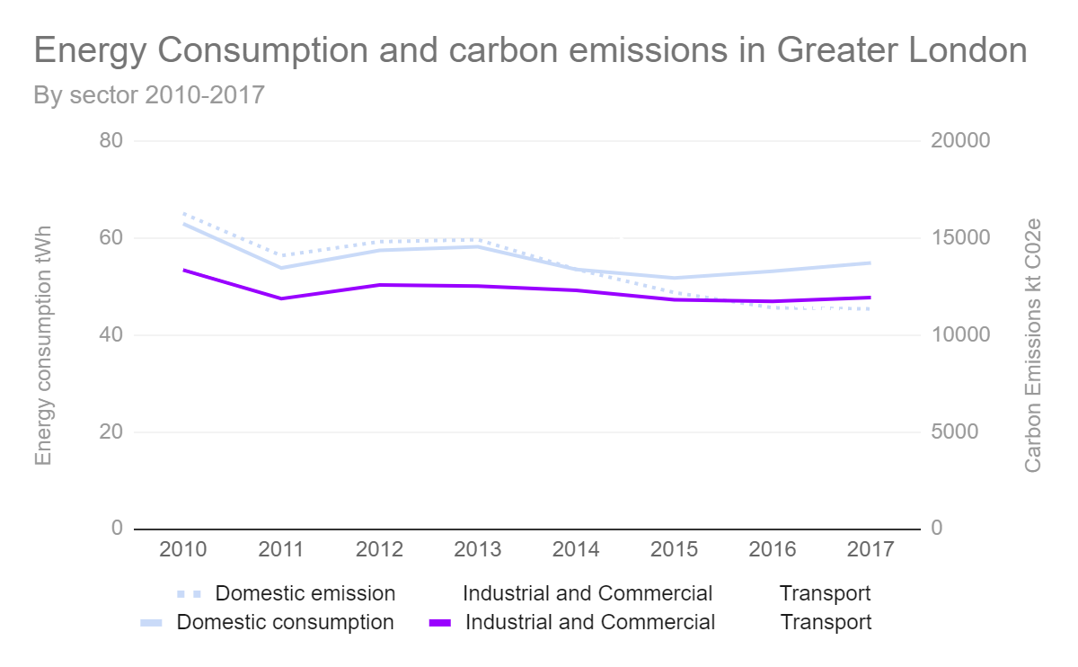
The Industrial and commercial sector consumes 36% of London’s energy.

Slide 38
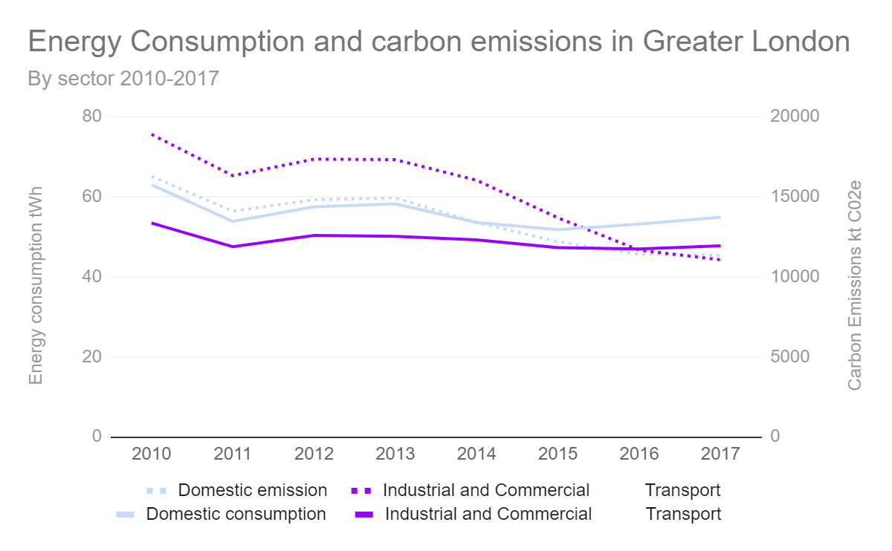
The Industrial and commercial sector consumes 36% of London’s energy.
But emits 41% of its carbon.

Slide 39
The Industrial and commercial sector consumes 36% of London’s energy.
But emits 41% of its carbon.
Emitting 2600 kt more carbon than the domestic sector

Slide 40
The Industrial and commercial sector consumes 36% of London’s energy.
But emits 41% of its carbon.
Emitting 2600 kt more carbon than the domestic sector
2013: Lower emissions

Slide 41
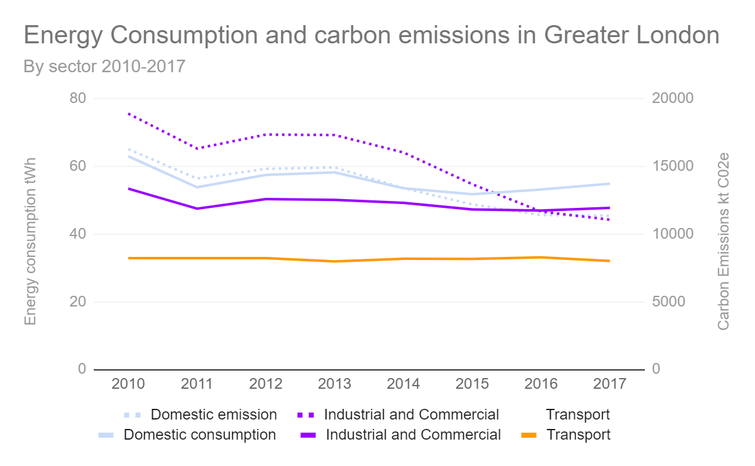
The transport sector consumes 23% of the energy in London.

Slide 42
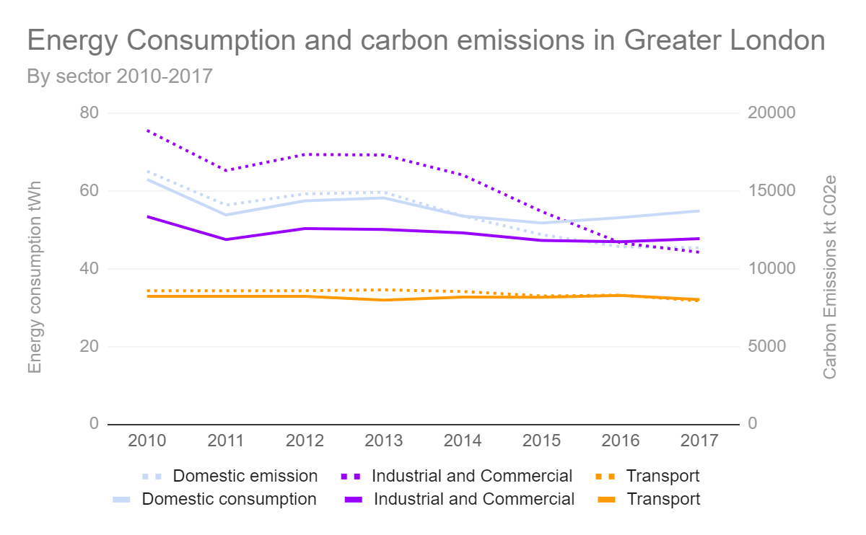
The transport sector consumes 23% of the energy in London.
But emits 22% of its carbon.

Slide 43
The transport sector consumes 23% of the energy in London.
But emits 22% of its carbon.
Little change in both from 2010 to 2017.

Slide 44
Questions
Why does the domestic sector consume more energy than it emits?

Slide 45
Questions
Why does the domestic sector consume more energy than it emits?
Why does the industrial and commercial sector emit more carbon than it consumes?

Slide 46
Questions
Why does the domestic sector consume more energy than it emits?
Why does the industrial and commercial sector emit more carbon than it consumes?
What happened in 2013 and 2014 when emissions dropped?

Slide 47
Questions
Why does the domestic sector consume more energy than it emits?
Why does the industrial and commercial sector emit more carbon than it consumes?
What happened in 2013 and 2014 when emissions dropped?
Was a cleaner fuel type used?

Slide 48
Questions
Was a cleaner fuel type used?

Slide 49
Mayor of London’s Waste policy
“We want to turn London waste into an opportunity – by reducing waste, reusing and recycling more of it and turning what’s left into low carbon energy.”

Slide 50
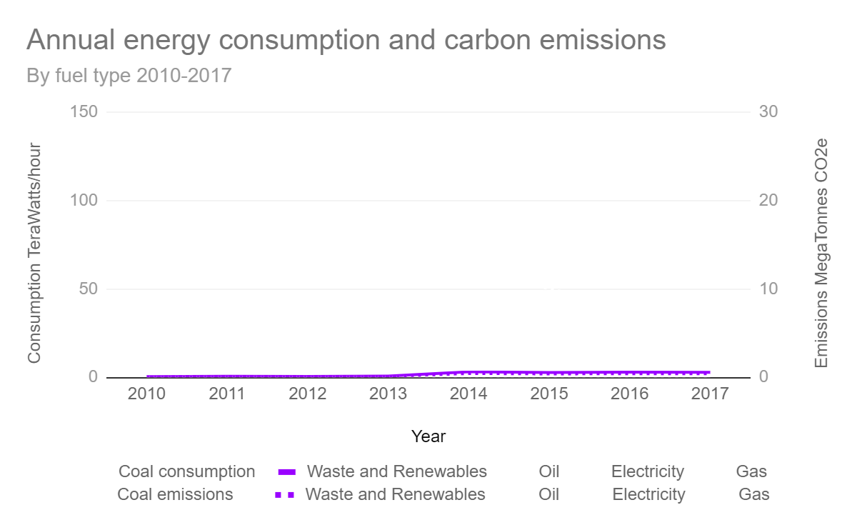
Waste and renewables
2013 +120 GigaWatts hour
2012 +2 448 GigaWatts hour
2010- 2017
+2 502 GigaWatts hour
0.8% energy consumption

Slide 51
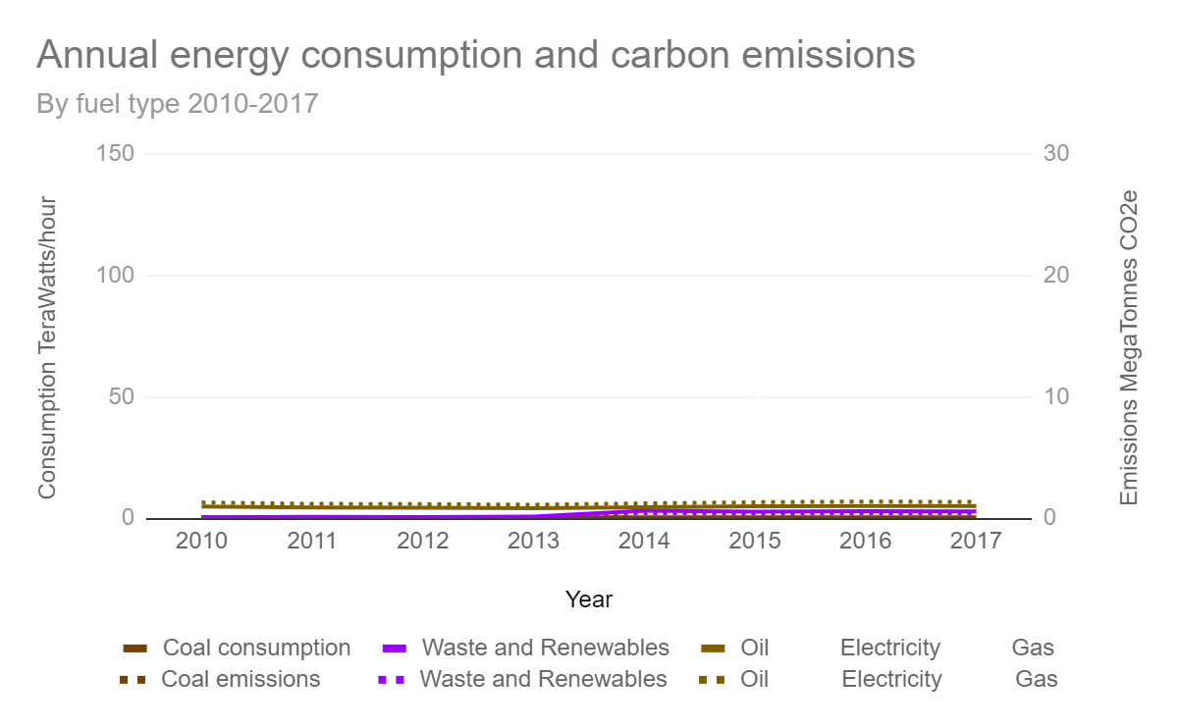
Coal
2010- 2017
-61 GigaWatts hour
0.17% energy consumption
Oil
2010- 2017
+181 GigaWatts hour
2.2% energy consumption

Slide 52
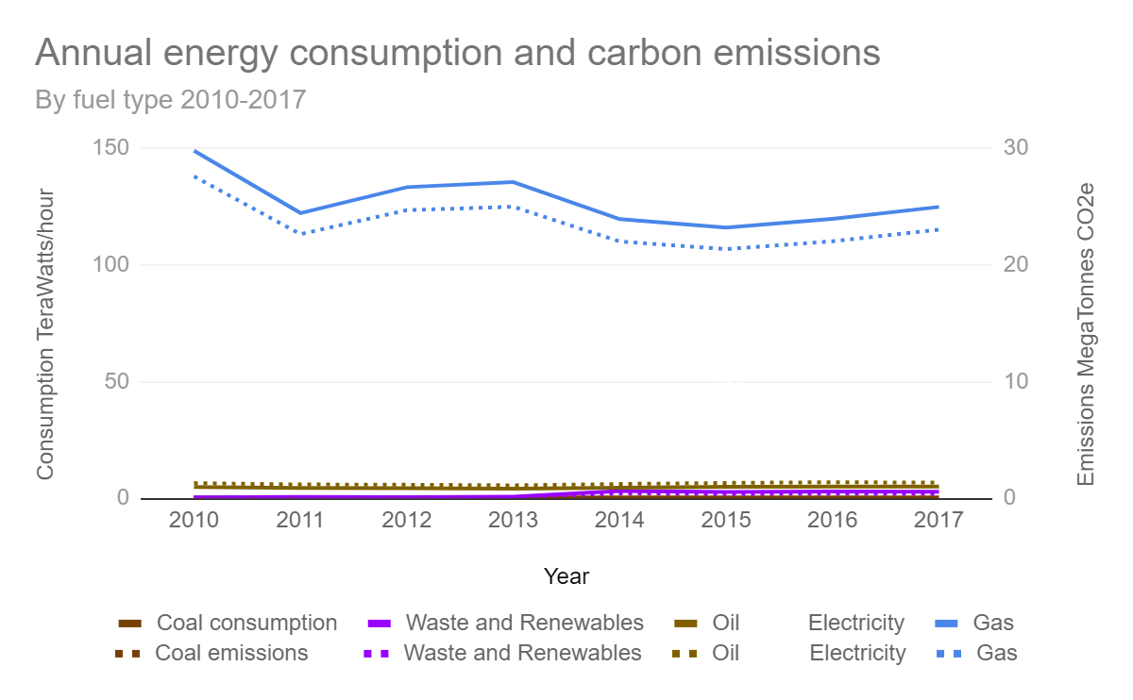
Gas
2011 -26 736 GigaWatts hour
2014 -15 833 GigaWatts hour
2010- 2017
-24 123 GigaWatts hour
60% energy consumption

Slide 53
Gas
2011 -26 736 GigaWatts hour
2014 -15 833 GigaWatts hour
2010- 2017
-24 123 GigaWatts hour
60% energy consumption
Little change in emitting less compared to consumption

Slide 54
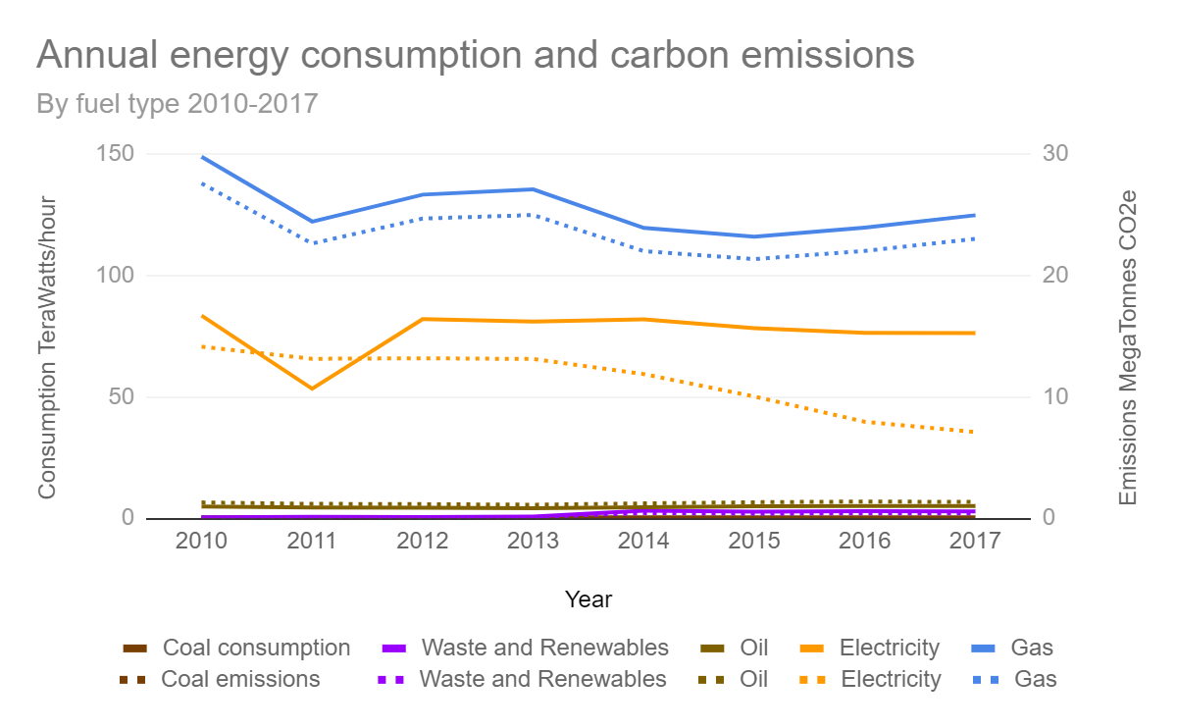
Electricity
2011 -30 109 GigaWatts hour
2012 +28 660 GigaWatts hour
2010- 2017
-7 226 GigaWatts hour
36% energy consumption

Slide 55
Electricity
2011 -30 109 GigaWatts hour
2012 +28 660 GigaWatts hour
2010- 2017
-7 226 GigaWatts hour
36% energy consumption
2013: Emission decreases
> Improved technology?
> Double counting renewables?

Slide 56
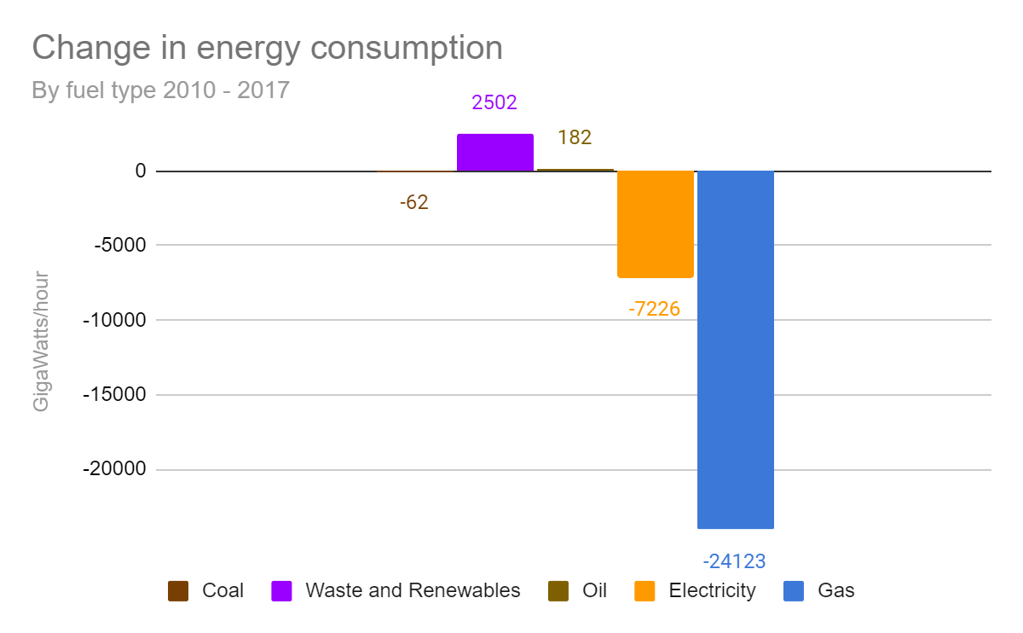
Energy consumption
Decreased
-28 727 GigaWatts hour
Increased
Waste and renewables
Oil

Slide 57
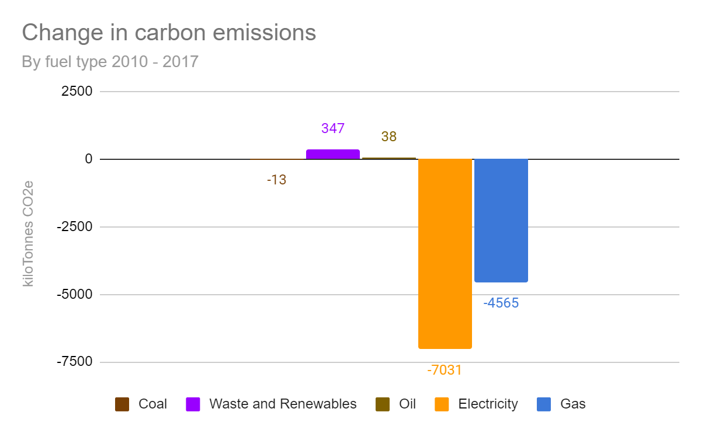
Carbon emissions
Decreased
-11 224 Kilotonnes CO2e
Increased
Waste and renewables
Oil

Slide 58
Carbon emissions
Decreased
-11 224 Kilotonnes CO2e
Increased
Waste and renewables
Oil
Reducing fossil fuel
Increasing greener fuel
> less emission

Slide 59
Question
Which London boroughs use the most energy?
33 London boroughs

Slide 60
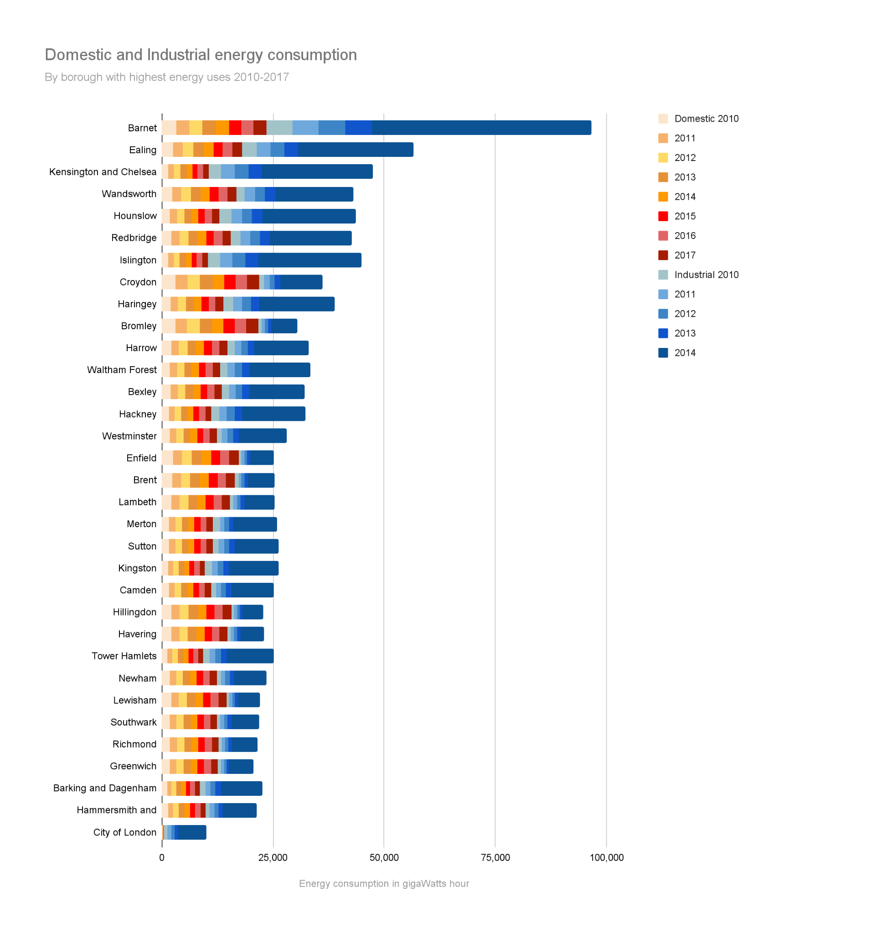
A London profile
Barnet consumes the most overall
The City of London consumes the least
Financial centre
Few residents

Slide 61
1
A London profile
5 highest industrial consumers are among the highest 10 London boroughs
2
3
5
4

Slide 62
1
1
A London profile
5 highest industrial consumers are among the highest 10 London boroughs
Domestic energy use lower compared to industrial
4
2
3
5
4
2
3
5

Slide 63
1
1
A London profile
5 highest industrial consumers are among the highest 10 London boroughs
Domestic energy use lower compared to industrial
Varied mix of industrial and domestic uses in the other boroughs
4
2
3
5
4
2
3
5

Slide 64
1
1
A London profile
5 highest industrial consumers are among the highest 10 London boroughs
Domestic energy use lower compared to industrial
Varied mix of industrial and domestic uses in the other boroughs
4
2
3
5
4
2
3
5

Slide 65
Question
Which boroughs have the biggest changes in energy consumption by sector?
Does this correlate with urban regeneration?
Industrial > residential

Slide 66
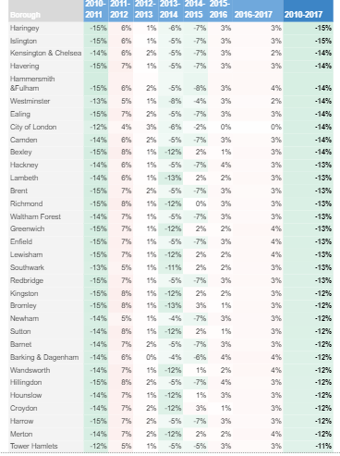
Domestic energy consumption
Decreased across all boroughs from 2010-2017
All boroughs decreased energy consumption in 2011.
All boroughs increased consumptions in 2012, 2013 and 2016.

Slide 67
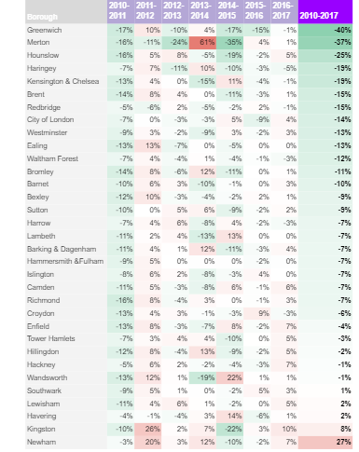
Industrial energy consumption
Generally decreased across all boroughs from 2010-2017
Greenwich, Merton and Hounslow decreased the most.
Newham increased by 27%. Smaller increases in Kingston, Havering and Lewisham.
Mixed picture on a year by year and borough basis.

Slide 68
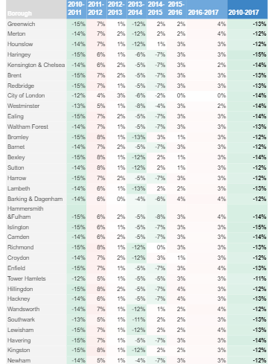
Industrial and domestic energy consumption
Since domestic consumption generally decreased from 2010-2017.
No visible correlation industrial > domestic use.

Slide 69
Industrial > domestic
Can take years from stopping industrial use, building new homes and for residents to move in
Industrial land strategy:
Move industrial use to another part of borough, or a different borough
Consolidate and intensify industrial land

Slide 70
Summary
The domestic sector consumes more energy than it emits.
The industrial and commercial sector emits more carbon than it consumes.
Emissions dropped in 2013 and 2014?

Slide 71
Summary
Electricity
2010- 2017
-7 226 GigaWatts hour
From 2013: Emission decreases
> Improved technology?
> Double counting renewables?

Slide 72
Summary
Decreased energy consumption and carbon emission
-28 727 GigaWatts hour, -11 224 Kilotonnes CO2e
Increased use in waste and renewables. Improved electricity production?

Slide 73
1
1
Summary
5 highest industrial consumers are among the highest 10 London boroughs
4
2
3
5
4
2
3
5

Slide 74
London is becoming greener

Slide 75
Recommendation
Improve production and efficiency in industrial use
> make the biggest impact in London.
Focus on Barnet borough
> Largest energy consumer of energy in domestic and industrial sectors
> Test bed for reducing use in both sectors

Slide 76
Further data exploration
What happened in 2012-2014 to reduce carbon emission?
Visualise borough’s change in energy consumption from a table onto a map
> take into account time to redevelop to see landuse change.
Calculate per capita
> energy consumption
> carbon emissions

